Slide 1
HR Analytics
To identify the best source of recruitment for a tech startup
Presented By : Madhumita Roy

Slide 2
Link For The code File
https://colab.research.google.com/drive/1y97v5-b9DzWmoptsIUpaLMh0ZNgub_Hu?usp=sharing#scrollTo=tvABJC1-FvbL

Slide 3
Objective
The objective is to recommend the most effective recruitment source through data-driven analysis of attrition rates and employee sales performance.

Slide 4
Buisness Problem
Employee Retention and Attrition: Identify recruitment sources that minimize employee attrition and prioritize channels that promote long-term retention.
Employee Performance (Sales Numbers): Assess recruitment sources that yield high-performing employees based on their sales output.
Optimizing Recruitment Strategy: Determine the most effective recruitment sources by analyzing historical data to balance employee retention and performance.
Data-Driven Recommendations: Provide actionable recommendations on recruitment sources for a tech startup, supported by an analysis of attrition and employee performance.
Maximizing ROI on Recruitment: Select recruitment sources that offer the best return on investment by ensuring both high retention rates and strong employee productivity.

Slide 5
Attrition Trends Across Recruitment Sources
1. Attrition by Recruitment Source: The chart shows attrition rates for employees recruited through different sources. The yellow portion of each bar represents the employees who have left (attrition), while the purple portion represents employees who are still with the company.
2. Recruitment Source with Highest Attrition: The "Applied Online" recruitment source has the highest number of employees and also the highest number of people leaving, indicated by the relatively large yellow portion compared to the other sources. This suggests that employees hired through online applications tend to leave the company at a higher rate.
3. Low Attrition Sources: Search Firm has the fewest hires overall, with attrition accounting for the entirety of its hires. The smaller numbers might make it less reliable, though it raises concerns about the quality of recruitment through this source.
4. Referral and Campus: These sources seem to have a moderate level of hires, but attrition is somewhat balanced in both cases, with significant purple and yellow sections. This indicates that while a notable number of employees from these sources leave, many also stay.
5. Overall Attrition Trends: The color gradient beside the chart provides additional insight, where a value of 1 (yellow) indicates full attrition and 0 (purple) indicates no attrition. This visualizes a pattern that attrition varies across recruitment channels.
In summary, the company might need to investigate why online recruits have the highest attrition and whether referral or campus recruitment is more effective at retaining talent compared to online applications.

Slide 6
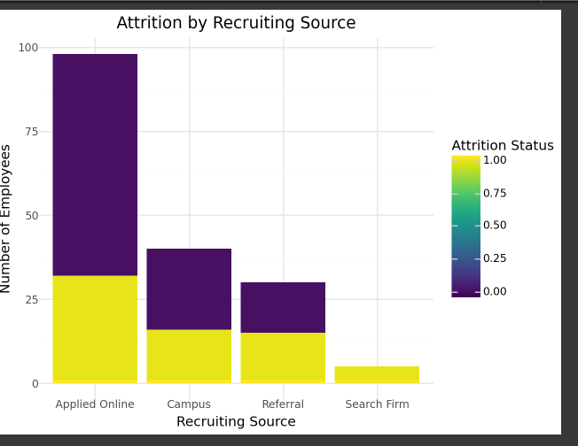

Slide 7
Sales Trends Across Recruitment Sources
1. Sales Contribution by Recruiting Source
Applied Online has generated the highest sales numbers, with over 17 million in sales. This indicates that employees recruited through online applications are contributing significantly to the company's revenue.
Campus recruitment follows with approximately 1.44 million in sales, showing that recruits from campus programs also contribute significantly, though less than those recruited online.
Referral recruits contribute about 1.17 million in sales, slightly lower than campus recruits but still a substantial figure.
Search Firm has the lowest sales contribution, with only around 265,000 in sales, indicating that employees hired through search firms contribute the least to overall sales.
2. The recruitment channel that brings in the most hires and sales (Applied Online) has high attrition, while smaller channels like Search Firm have lower sales and attrition. The company may need to assess whether it’s more valuable to retain employees with lower sales numbers or continue focusing on recruitment channels that bring in high-revenue employees, even with higher turnover.
3. The company may want to further analyze the cost-benefit of each recruitment channel, focusing not only on retention but also on the sales performance of employees from different sources.

Slide 8
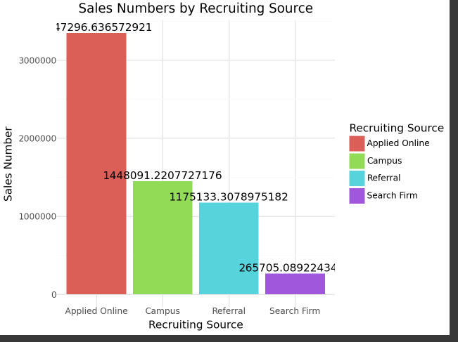

Slide 9
Recruitment Source Evaluation
1. Sales Performance vs. Attrition
Applied Online generates the highest sales but also has the highest attrition rate. While this source brings in high-performing candidates, the startup may experience higher costs due to frequent turnover. For a tech startup where retaining talent is crucial, this may not be the best choice unless strategies are implemented to improve retention.
Campus Recruitment offers a good balance. It has moderate sales performance (second after Applied Online) and a reasonable attrition rate. Tech startups looking for young talent, especially those eager to grow and innovate, could benefit from campus recruits who stay longer and contribute steadily to sales.
Referral recruits have slightly lower sales than Campus recruits but also show moderate attrition. Referral candidates are often more familiar with the company culture, so they may be easier to retain, making this source particularly valuable for a tech startup that prioritizes fit and collaboration within small, dynamic teams.
Search Firm contributes the least in terms of both sales and attrition. While attrition is low, the contribution to sales is not sufficient to justify the costs for a tech startup, especially when budget constraints are usually a concern.
2. Best Fit for a Tech Startup
Referral Recruitment: Referrals strike a good balance between sales performance and retention. Employees hired through referrals may already have some understanding of the company’s culture and can fit in more quickly, which is vital for a startup that requires quick adaptation. Since their attrition rates are lower compared to Applied Online and Campus recruits, referral hiring can lead to a more stable team.

Slide 10
Campus Recruitment: This could be the ideal second choice for a startup. Fresh graduates bring new ideas, adaptability, and enthusiasm. Their sales performance is strong, and while attrition is moderate, campus recruits are often open to growth and learning, which could lead to longer tenures when properly nurtured in a tech startup environment.
Applied Online: While this source delivers the best sales performance, the high attrition could strain a startup. However, if the focus is on rapid growth and scaling quickly, this source may provide high-value talent in the short term, with a focus on improving retention strategies.
3. Sales Contributions vs. Stability
Long-term Stability: Referrals and Campus recruits are more stable, as their attrition rates are lower compared to Applied Online. These sources can form a reliable core team that is vital for early-stage growth.
High Initial Impact: Applied Online candidates can drive strong short-term results, which can be useful for high-impact roles. However, a startup would need to put in place retention mechanisms to reduce the high attrition.
4. Recruitment Strategy Recommendation
Primary Focus: Based on this analysis, referral programs should be a key recruitment strategy for a tech startup. It’s the most cost-effective, leads to lower attrition, and ensures candidates are culturally aligned, which is crucial in fast-moving, collaborative startup environments.
Supplementary Approach: Campus recruitment should also be actively pursued to access fresh, innovative talent. Investing in long-term retention programs, such as career growth opportunities, could help reduce attrition.
Cautious Use of Online Recruitment: While Applied Online is effective in bringing high-performing individuals, the startup should be cautious of the high turnover and develop strategies such as personalized onboarding, mentoring, and career development to retain these hires.

Slide 11
Recommendation
Primary Focus: Referral Programs
Referral recruitment should be the core strategy for the tech startup due to its strong balance between sales performance and retention. Candidates recruited through referrals are culturally aligned and demonstrate lower attrition rates, making them ideal for creating a stable, collaborative team. This will lead to cost savings in recruitment and training while ensuring a more engaged workforce.
Supplementary Focus: Campus Recruitment
Campus recruitment offers fresh talent with a strong sales performance and moderate attrition. By investing in retention programs like mentoring, growth opportunities, and career development, the startup can retain these recruits for the long term and harness their potential for innovation.
Cautious Use of Online Recruitment
While online recruitment brings in high-performing individuals, its high attrition could be costly. The startup should proceed with caution and focus on retention strategies like personalized onboarding, regular mentorship, and career development to make this source more sustainable. This strategy could be effective for short-term, high-impact roles where immediate results are required.

Slide 12
Conclusion
For a tech startup looking to optimize recruitment strategies based on performance and retention, referral programs and campus recruitment should be the primary focus. Applied Online recruitment can still be used for quick scaling in high-impact roles but should be balanced with strategies to minimize attrition.

